Slide 1
Visual Analysis for Instructors
Damien Bogan

Slide 2
Goal of My Project: Analyze the passing rate/rolling passing rate for a group of instructors in each semester, hence automatically the code should work for an individual instructor when the group has a size 1. You should have at least two examples. One is for an individual, and one is for a group.

Slide 3
Overview of the Instructors
Instructor | count
Zduuhq, Iuhlgd | 2669
Nxuvxq, Rofdb | 2106
Bdq, Kxd | 1872
Djd, Prvlvd | 1349
Sdxon, Udfkho | 1310
Kdqg, Fkhubo | 1195
Prruh, Olol | 1082
PfGrqdog, Joruld | 1071
Zx, Ohl | 988
Ydohqwlqh, Vdudk | 930
The display of instructors are given below:
['Bdq, Kxd' 'Bhshc Pduwlqhc, Pdxulflr M' 'Ckdqj, Blihl' 'Djd, Prvlvd' 'Dodwwdu, Dvkudi' 'Doeuhh, Dqvrq' 'Doohq, Hchoo' 'Dphuvrq, Jdub' 'Dvkrndq, Vkduplod' 'Ehoolr Ulqfrq, Jlrydqql' 'Ehuub, Mrugdq' 'Ekdwwdfkdubd, Vxwdqx' 'Ekdwwdfkdubd, Wdwkdjdwd' 'Erer, Obqghh' 'Erkdqqrq, Mrkq' 'Eurzq, Vfrww' 'Exhqjhu, Dqwkrqb' 'Fdvlplu- Sdwwrq, Eholqgd' 'Fkhq, Bxh' 'Fkhq, Wldqudq' 'Fodun, Vdoob' 'Free, Zdqjvkx' 'Fxhyd-Sduud, Oxlv' 'Fxl, Bxh' 'Gdubdqdql, Mrkqqb' 'Gduohb, Dxuhold' 'Gdylv, Fdol' 'Gdylv, Sdxo' 'Glqf, Vhplk' 'Grxjkhuwb, Pdub' 'Gxqfdq, Eubfh' 'Jdr, Cklplq' 'Jrggdug, Mhurph' 'Jrgzlq, Sulvflood' 'Jrnxo, Qludqmdq' 'Jxkd, Dwdqx' 'Kdqg, Fkhubo' 'Kduglqj, Kdqqdk' 'Kduprq, Pdub' 'Krrg, Vdpdqwkd' 'Kruqh, Wzlod' 'Kxdqj, Fkhqj' 'Kxdqj, Fkhqj-Fkl' 'Mdfnvrq, Grqqd' 'Mhiihuvrq, Eduedud' 'Mxqnhu, Mrho' 'Ndudelehu, Idwlk' 'Nrwdpudmx, Ndvkbds' 'Nxuvxq, Rofdb' 'Ohh, Mlqsbr' 'Ohh, Nlq' 'Ol, Zhl' 'Olqduhv, Mhvxv' 'Olskdp, Gdylg' 'Olx, Brqjalq' 'Or, Wlqj Wr' 'PfGrqdog, Joruld' 'Prqlqvnl, Dqwkrqb' 'Prruh, Olol' 'Pruwrq, Vfrww' 'Sdsh, Sdwulfn' 'Sdun, Mlhxq' 'Sdxon, Udfkho' 'Shhoh, Ukrghv' 'Shuhjrb, Mduhg' 'Srzhoo, Mrdq' 'Sudekdndu, Dqqlh' 'Udjodqg, Pdwwkhz' 'Udkedulqld, Ededn' 'Udwwdq, Fduro' 'Uhhg, Qlfroh' 'Vdklqrjox, Phkphw' 'Vfkplgw, Ehwwlqd' 'Vplwk, Ixupdq' 'Vplwk, Oxnh' 'Vroohb, Zdbqh' 'Vshdu, Pdub' 'Vwdqilhog, Ohwkhqxdo' 'Wdqj, Zhq' 'Wldq, Clbdq' 'Wxoolv, Vkdbod' 'Wxun, Pbod' 'Xqghuzrrg, Urehuw' 'Ydohqwlqh, Vdudk' 'Yhqndwudp, Sudprg' 'Zdqj, Bl' 'Zdqj, Fkhqjihl' 'Zdqj, Fkhqjjdqj' 'Zduuhq, Iuhlgd' 'Zlqwhu, Urgqhb' 'Zx, Ohl'] The number of unique instructors in the dataset are: 91
There are 91 instructors, but I want to concentrate on the top ten, using one as an example for the passing rate and rolling passing rates and two as my group of instructors to compare their passing rates and rolling passing rates.
The number of students taught by the top 10 instructors are plotted below.

Slide 4
Top 10 Instructors Taught by Students
In the next slides I will present a bar plot of the top 10 instructors by students taught.
Start the y-axis at 0
According to Schwabish P. 69, “we perceive the values in the bar chart from the length of the bars, starting the axis at something other than zero may emphasize the differences between the bars and bias our perception.”
Another essential factor is the color scheme for a bar plot.
Sequential Colormap
This colormap has consistent brightness throughout the spectrum, allowing for the same emphasis on all instructors

Slide 5
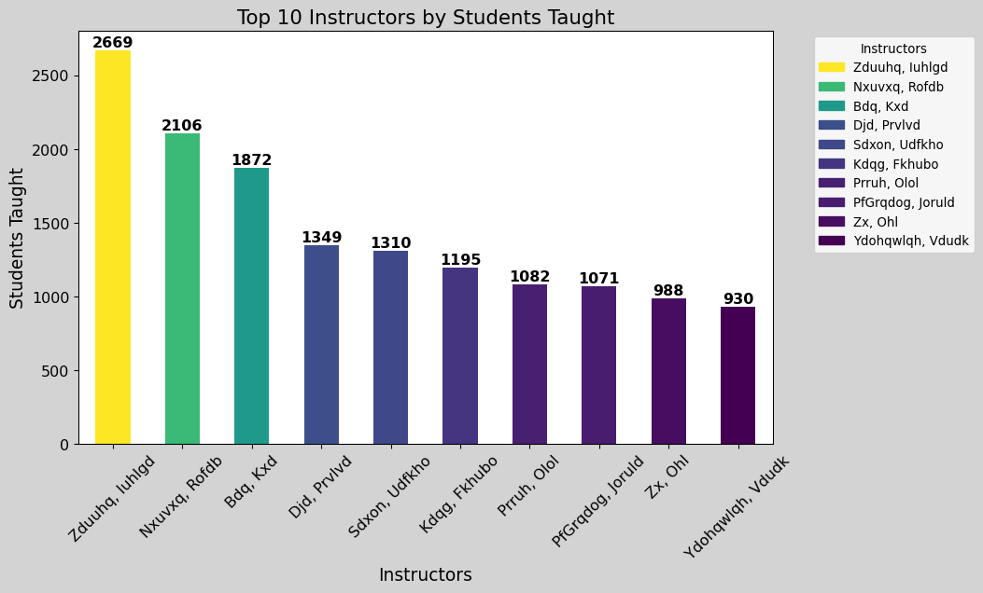

Slide 6
Questions
Are the use of tick marks needed in the barplot?
Yes, for my bar plot the use of the tick marks makes it easier to see the data assigned the instructor.
Does the bar plot need a grid line?
No, the values above the bars give emphasis of the number of students taught.
Should the names be aligned on the y-axis vertically instead of a forty-five-degree rotation on the x-axis?
No, aligning the names on the y-axis will perhaps flip the bars horizontally. This will make the values on the bar difficult to see, unless I delete those values and leave as is. If this is considered, then yes.
Is the legend needed in the bar plot?

Slide 7
 | Passing Count | count
0 | A | 10181
1 | B | 4544
2 | C | 2806
3 | B+ | 2423
4 | CR | 2145
5 | B# | 1470
6 | A# | 1193
7 | C# | 1169
8 | C+ | 932
9 | S | 932
10 | AU | 16
Passing Grades

Slide 8
 | Failing Count | count
0 | W | 1830
1 | D | 1043
2 | F# | 978
3 | F | 827
4 | FAN | 774
5 | F* | 345
6 | FA | 299
7 | D+ | 254
8 | U | 171
9 | NC | 147
10 | F** | 140
11 | D* | 86
12 | FA* | 72
13 | FA** | 22
14 | D# | 12
15 | I | 7
16 | D+* | 4
17 | IP | 1
18 | NR | 1
Failing Grades

Slide 9
Instructor | count
Zduuhq, Iuhlgd | 2185
Nxuvxq, Rofdb | 2016
Bdq, Kxd | 1738
Djd, Prvlvd | 1127
Kdqg, Fkhubo | 921
Zx, Ohl | 900
Sdxon, Udfkho | 843
Prruh, Olol | 794
PfGrqdog, Joruld | 708
Ydohqwlqh, Vdudk | 644
The number of students with passing grades from top 10 instructors

Slide 10
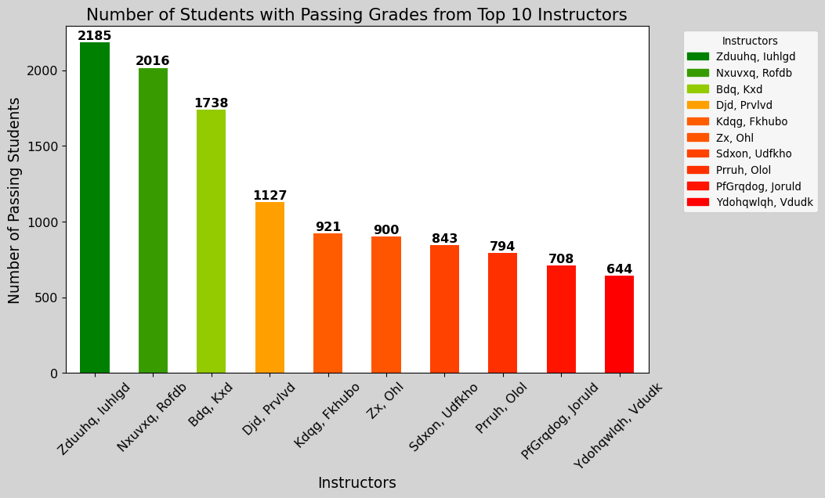

Slide 11
Question
Instead of a gradient color choice from green to red. Is there a better way to emphasize color for instructors with more passing students than less passing students?

Slide 12
Instructor | count
Zduuhq, Iuhlgd | 484
Sdxon, Udfkho | 467
PfGrqdog, Joruld | 363
Prruh, Olol | 288
Ydohqwlqh, Vdudk | 286
Kdqg, Fkhubo | 274
Djd, Prvlvd | 222
Bdq, Kxd | 134
Nxuvxq, Rofdb | 90
Zx, Ohl | 88
The number of students with failing grades from the top 10 instructors

Slide 13
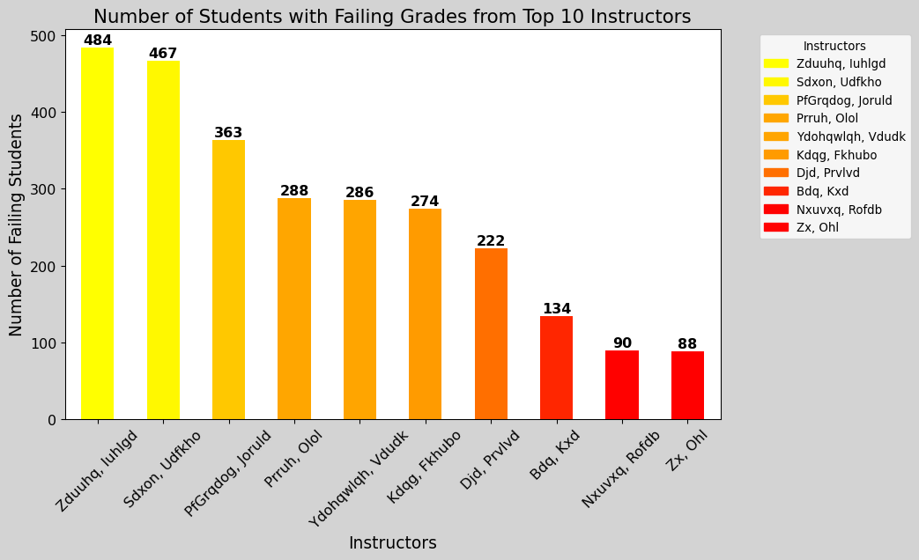

Slide 14
Question
Is there a better way to emphasize color for instructors with less failing students than more passing students? Why not choose colors from red gradient to green?

Slide 15
Passing Rate (%) vs. Passing/Failing Rates
The passing rate (%) is directly correlated with the number of passing students.
Increase in passing students -> increase in passing rate percentage
Increase in failing students -> decrease in passing rate percentage

Slide 16
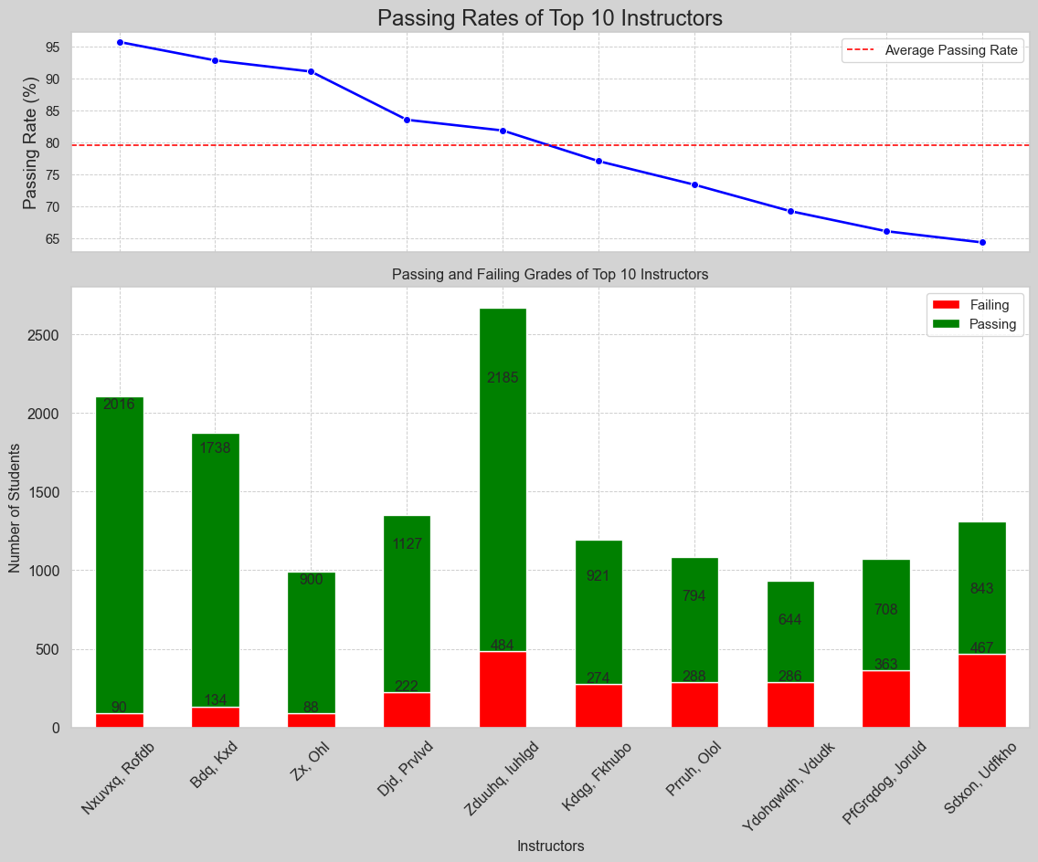

Slide 17
Passing Rates of Top 10 Instructors
A better visual for this graph will be
Add tick marks under bars
Remove grid lines and emphasize values in the bar plot
Remove grid lines and emphasize passing rate percentage value
The biggest challenge of creating the plot was emphasizing the values on the bars and the color separation

Slide 18
Passing Rate (%) vs. Passing/Failing Rates
The passing rate (%) is directly correlated with the number of failing students.
Increase in failing students -> increase in failing rate percentage
Decrease in failing students -> decrease in failing rate percentage

Slide 19
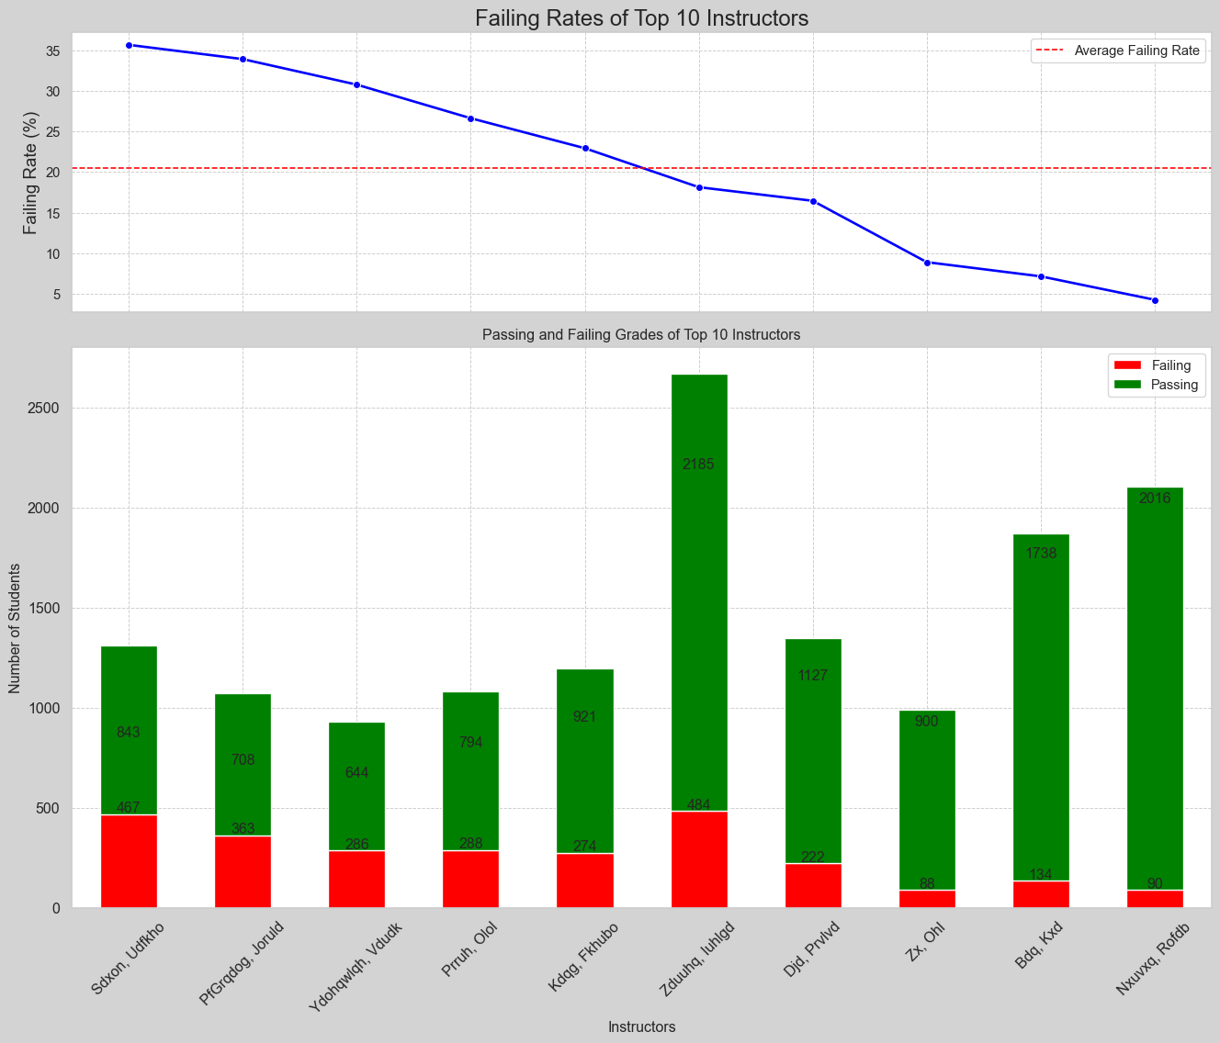
Failing Rates of the Top 10 Instructors vs. the Passing and Failing students taught by the Top 10 Instructors.

Slide 20
Now that we have a taste of visuals for Instructors passing and failing rates of their students taught. I am now going to dive into my visual analysis for the passing rate/rolling passing rate for a group of instructors, but before I do so let’s look at the tables for the passing/rolling rate of two instructors. The three instructors I will use are ‘Nxuvxq, Rofdb’ (highest passing rate), ‘Bdq, Kxd’ (second highest passing rate), and ‘Djd, Prvlvd’.

Slide 21
Analysis by Instructors
Term | 202403 | 202501 | 202502 | 202503 | 202601 | 202602 | 202603 | 202701 | 202702 | 202703
Instructor
Bdq, Kxd | 94.3 | 90.6 | 82.7 | 98.1 | 92.6 | 93.6 | 98.8 | 96.7 | 95.3 | 100.0
Djd, Prvlvd | 92.3 | 82.2 | 85.4 | 85.4 | 80.2 | 71.0 | 80.0 | 81.6 | 86.4 | 83.3
Nxuvxq, Rofdb | ** | 93.8 | 90.9 | 100.0 | 96.4 | 98.9 | 97.5 | 96.4 | 96.4 | 95.0
Dept | 70.9 | 64.8 | 62.6 | 70.0 | 64.2 | 64.8 | 76.7 | 70.0 | 68.5 | 86.7
Passing Rate Table

Slide 22
Term | 202403 | 202501 | 202502 | 202503 | 202601 | 202602 | 202603 | 202701 | 202702 | 202703
Instructor
Bdq, Kxd | 90.8 | 90.7 | 88.9 | 89.7 | 89.6 | 91.2 | 91.8 | 94.1 | 95.7 | 95.7
Djd, Prvlvd | 83.3 | 83.0 | 81.9 | 82.5 | 83.5 | 81.1 | 80.0 | 79.9 | 80.5 | 80.2
Nxuvxq, Rofdb | ** | 93.8 | 91.9 | 93.4 | 94.5 | 95.4 | 95.5 | 95.9 | 97.3 | 96.9
Dept | 77.6 | 75.1 | 70.0 | 69.3 | 66.9 | 64.8 | 65.2 | 66.4 | 67.5 | 68.2
Rolling Rate Table

Slide 23
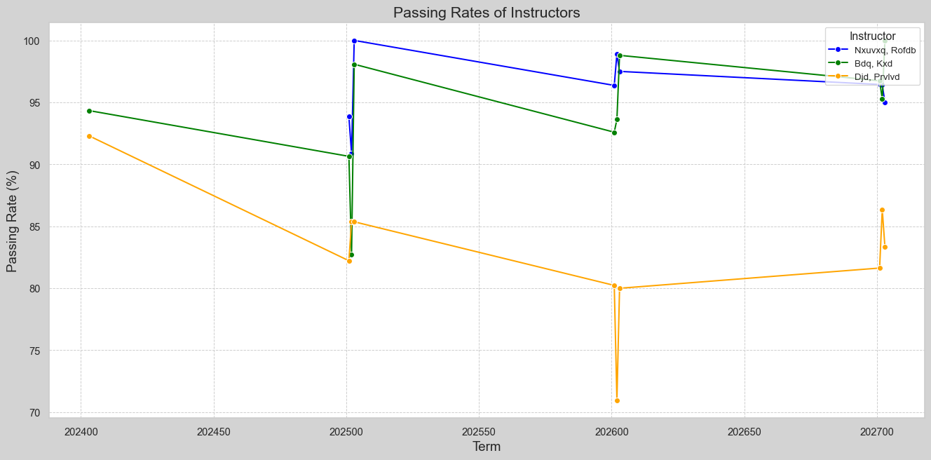

Slide 24
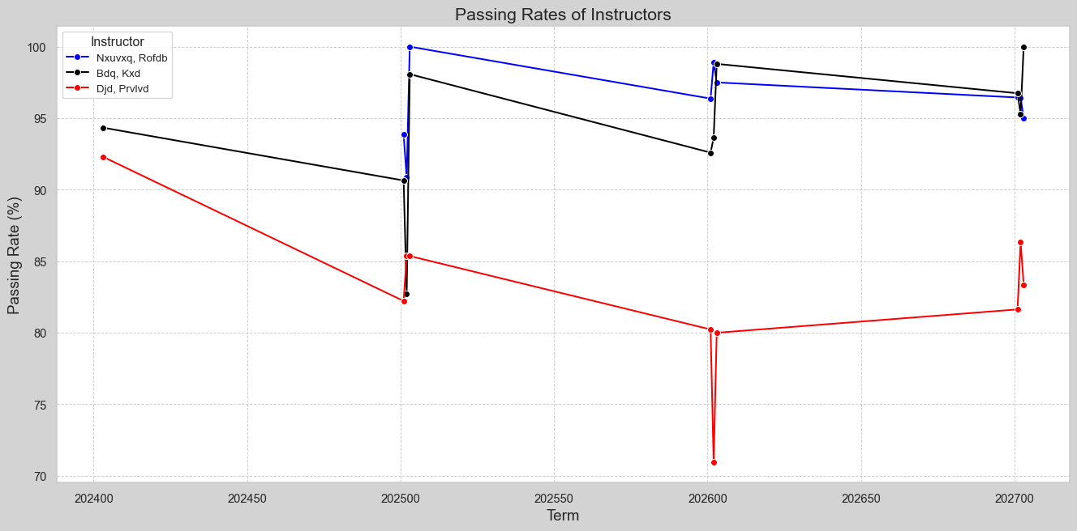

Slide 25
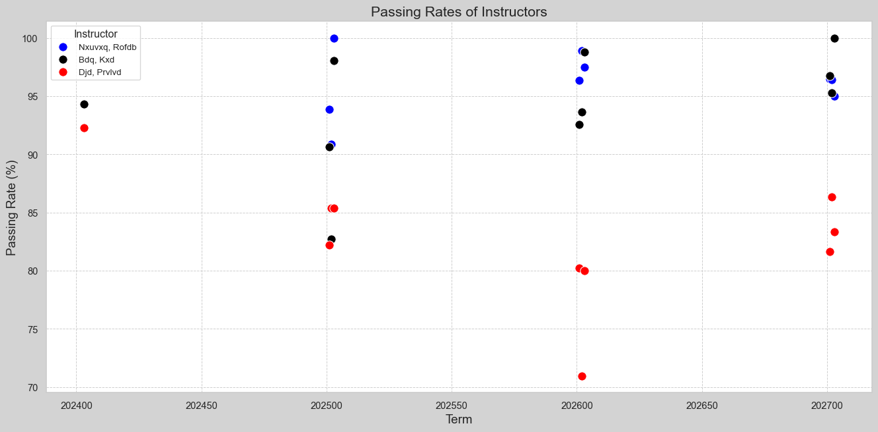

Slide 26
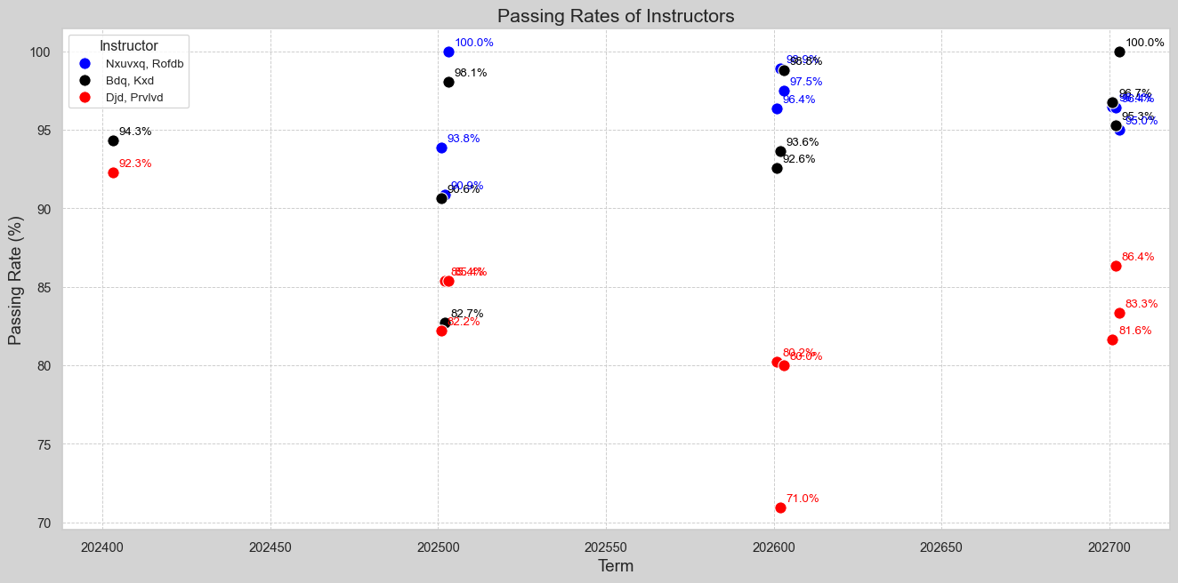

Slide 27
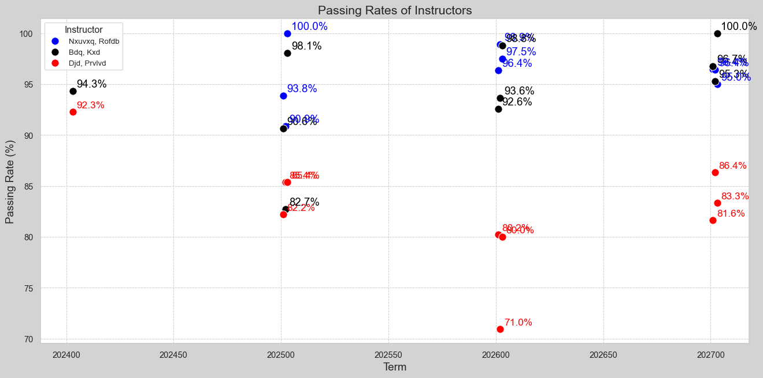

Slide 28
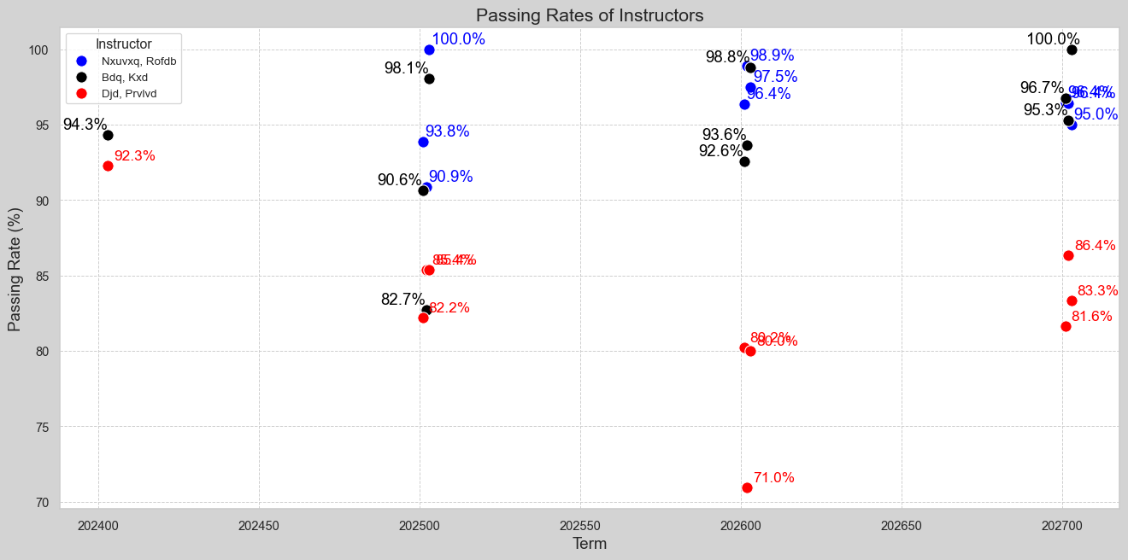

Slide 29
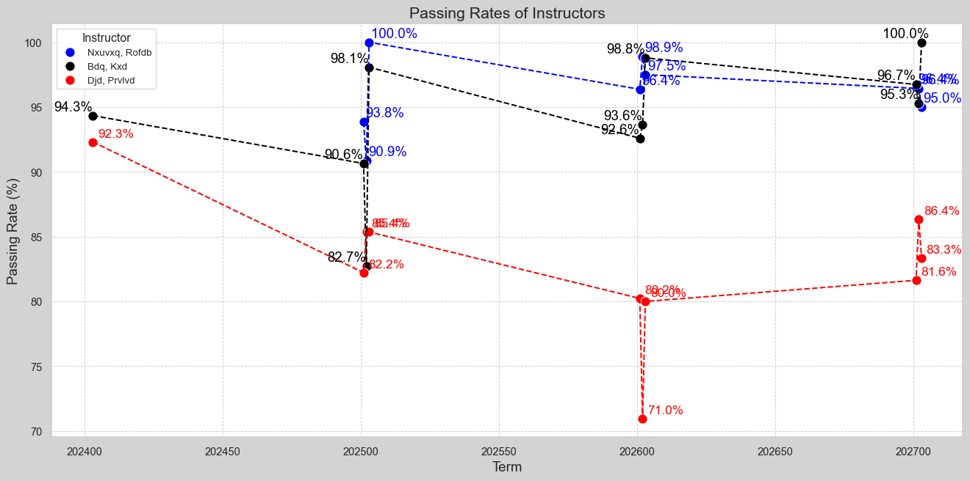

Slide 30
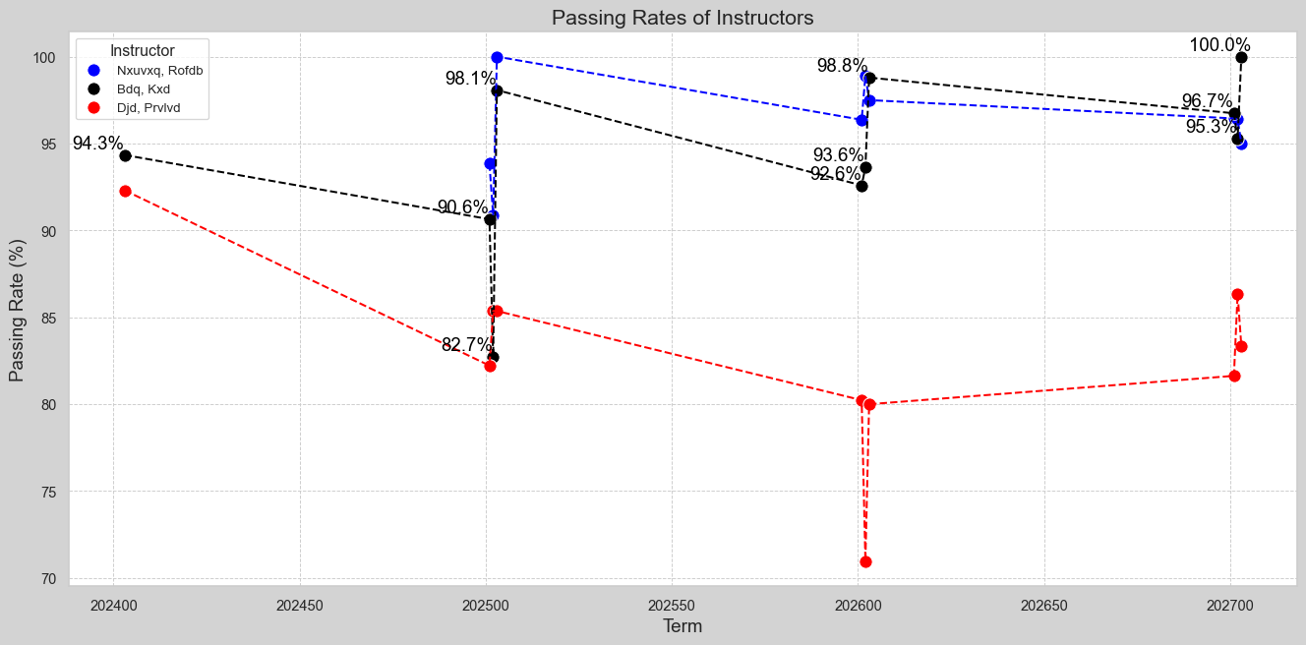

Slide 31
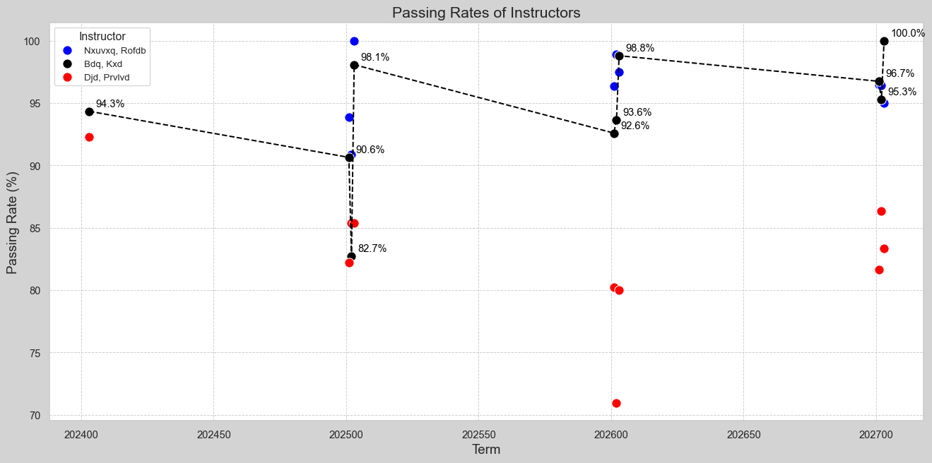

Slide 32
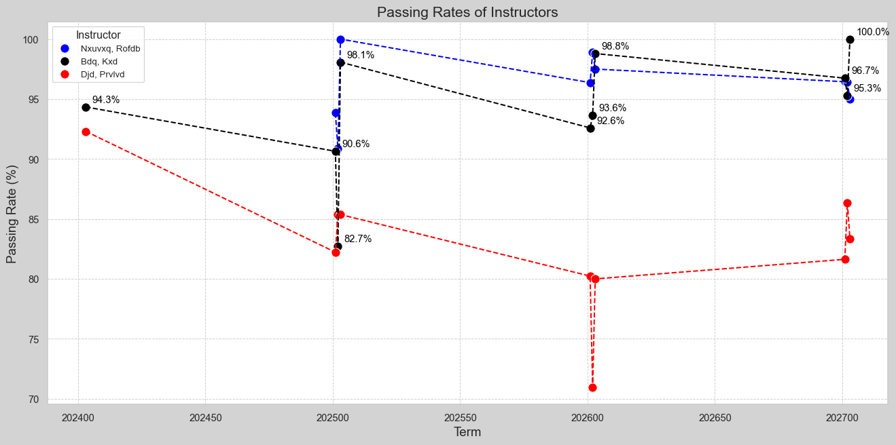

Slide 33
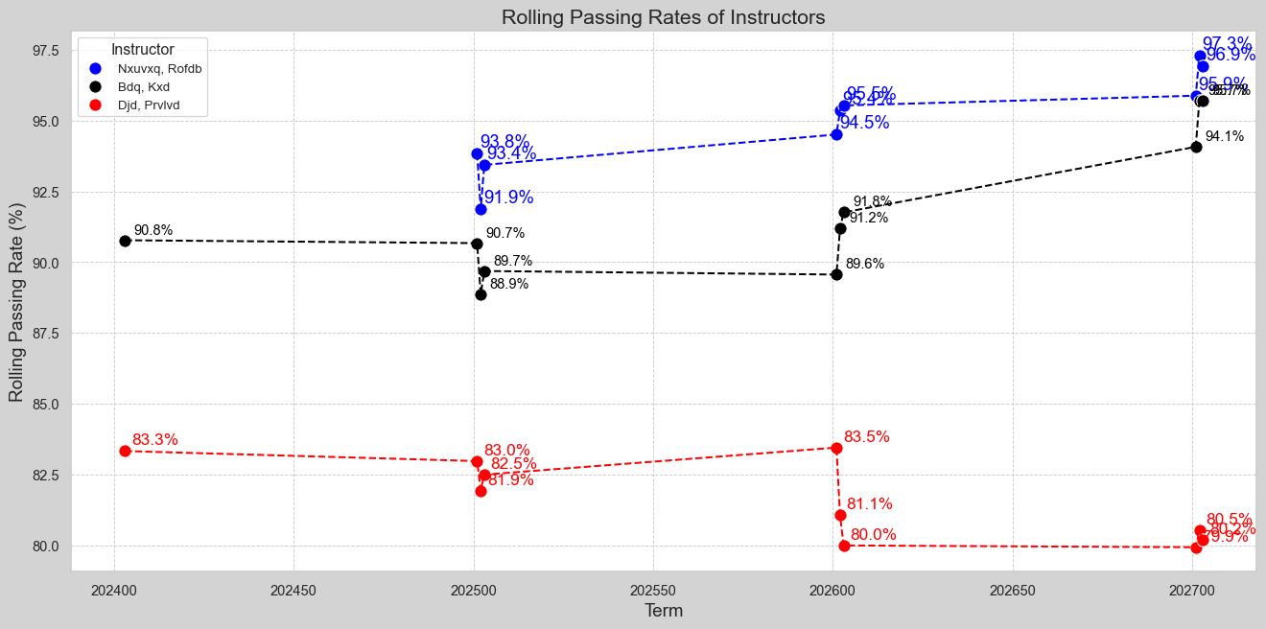

Slide 34
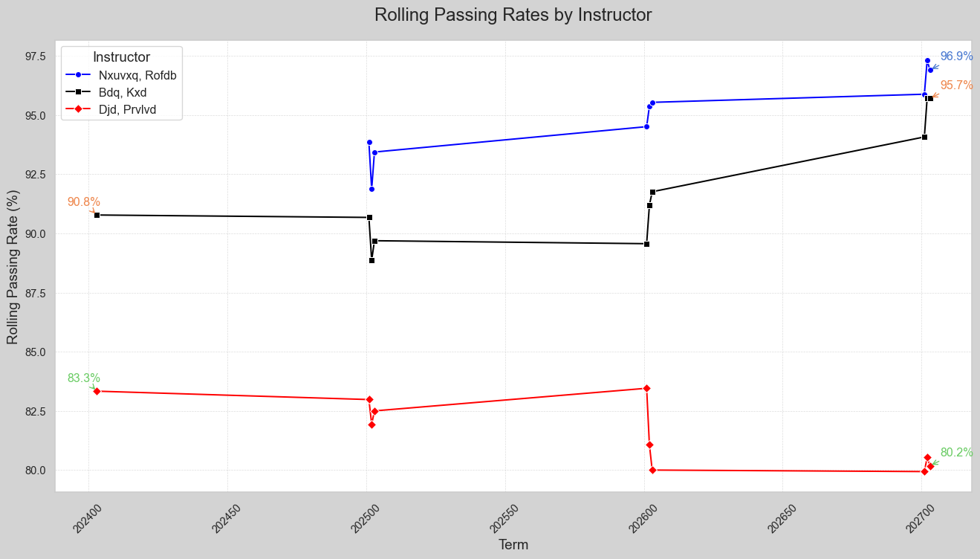

Slide 35
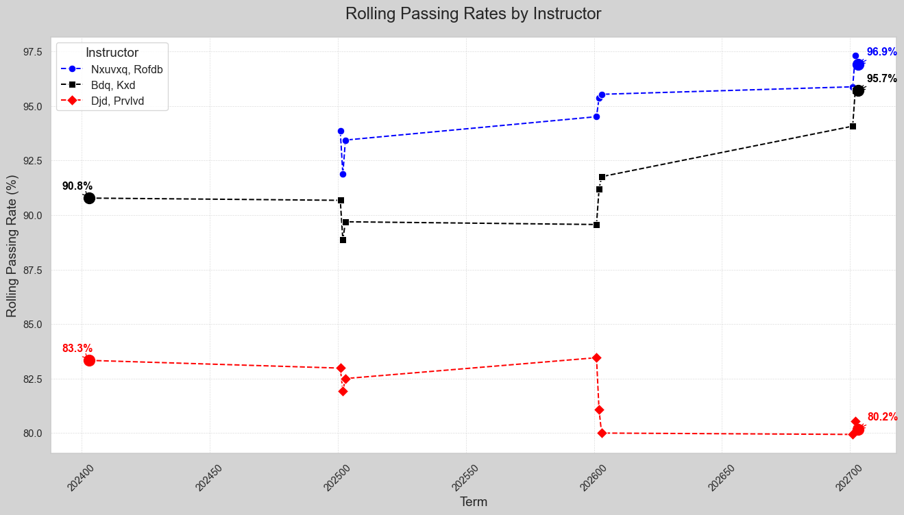

Slide 36
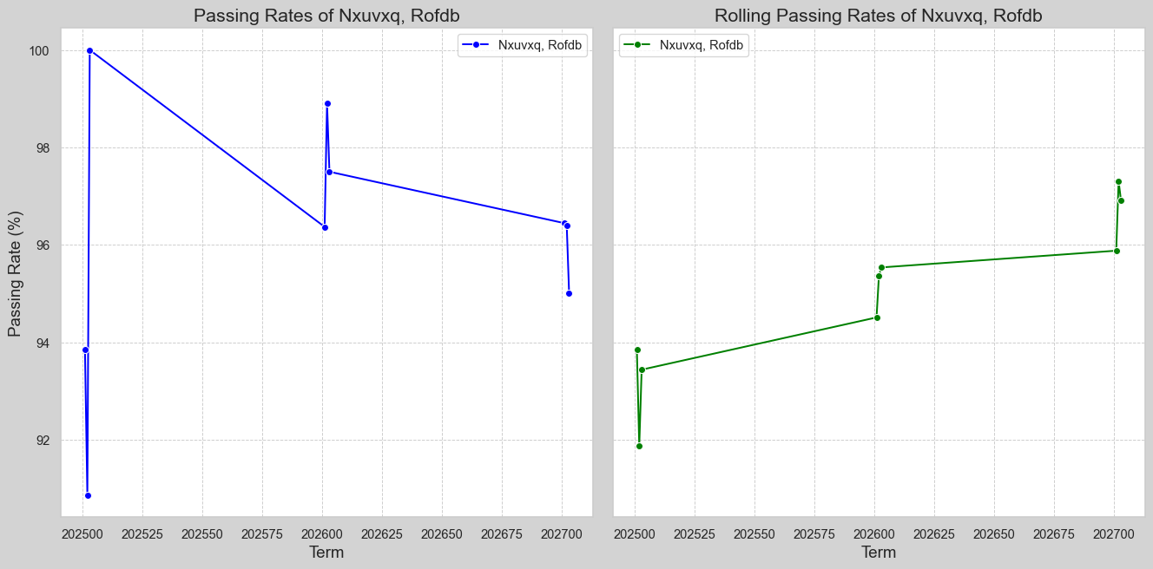

Slide 37
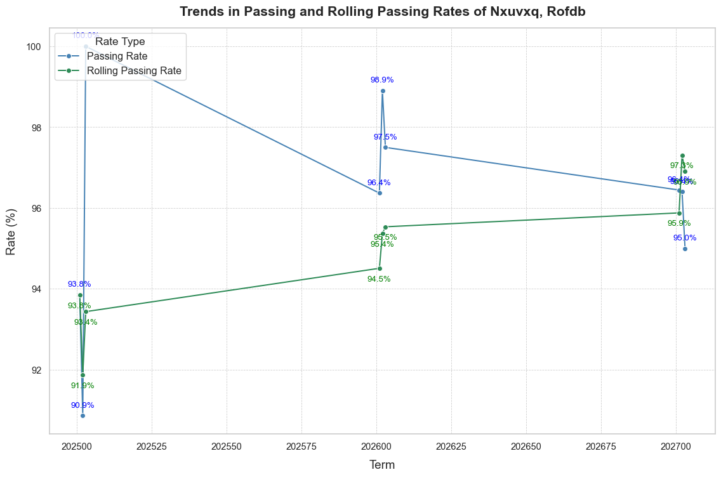

Slide 38
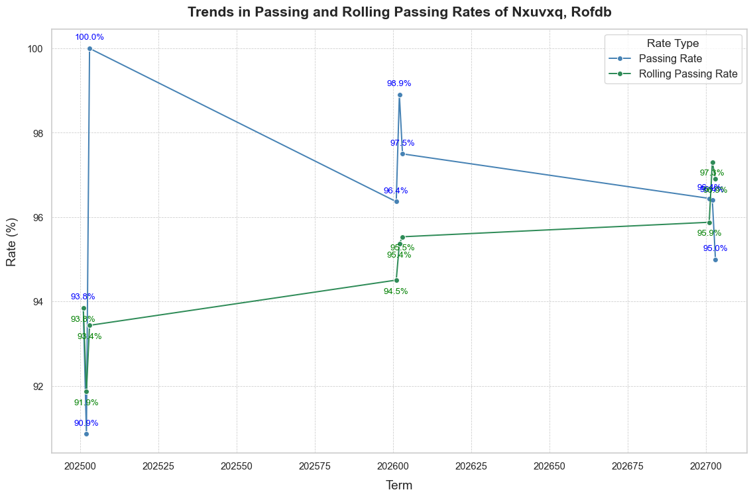

Slide 39
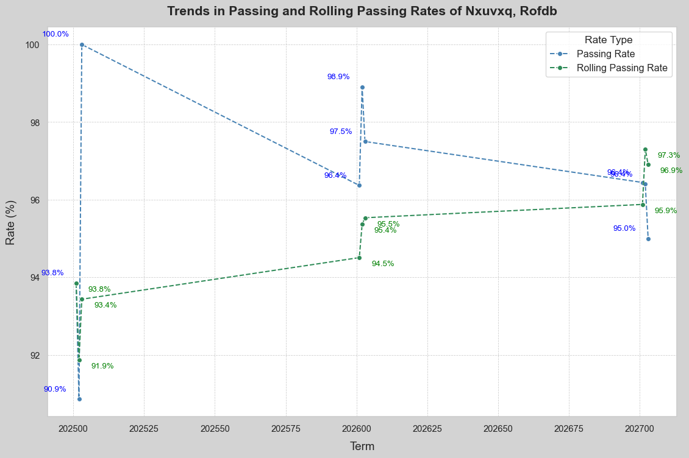

Slide 40
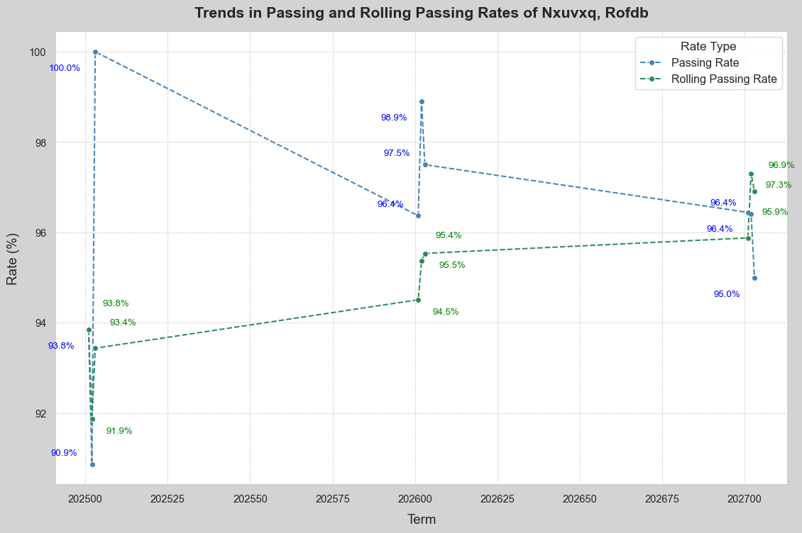

Slide 41
Comments on my line charts for Instructors
In my visuals I was able to distinguish the colors wisely. Gave use of the dashed lines, for the case of any missing values. I also was able to avoid dual axis line charts. On the other hand, I should have split the graphs into two instead of combining for a better comparison. The downside to my charts are the limited annotations, use of percentage values, data markers etc… just to name a few.

Slide 42
Radar Chart
Radar charts are like parallel coordinate plots, but the lines wrap around a circle instead of being arranged to one another (Schwabish 267).
Pros: Excellent for multi-dimensional data in compactness
Cons: interpretation for many variables
Another reason this radar chart benefits an individual instructor is
Radial view of instructor's performance
Easier to identify patterns?
Is the chart well-balanced? A well-balanced chart indicates consistency
Identifies strengths and weaknesses
Is it more interactive than the line chart?

Slide 43
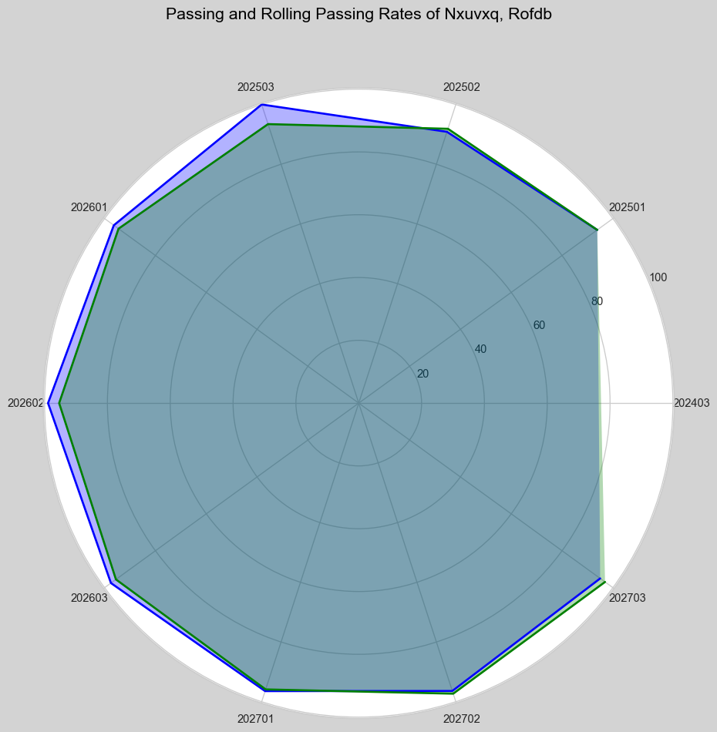

Slide 44
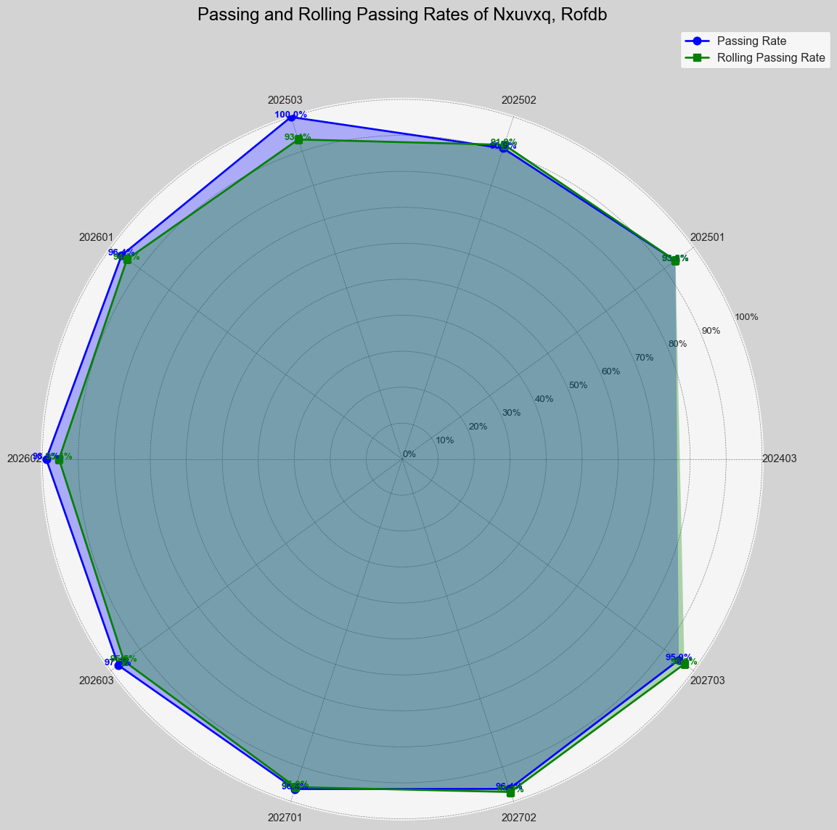

Slide 45


Slide 46
Conclusion
I found each plot to be challenging in its own way. I struggled to overcome the challenges of producing better visuals compared to those presented. I learned more than expected when creating subplots, axes, assigning values, labels, fonts, and backgrounds. I enjoyed the learning process and will continue to develop in this area of visualization.

